Slide 1


SCOUT
Automatically Protect & Empower Data

Slide 2
















The Data Economy Is Broken
Your IP is being stolen to train AI
353 Million
People affected by data breaches in 2023 alone
“People are waking up to the need for creating guardrails around data”
Senior Director @
$200B
Market size for big data in 2023 according to a study conducted by the Harvard Business Review
Microsoft, Meta and Bloomberg used thousands of copyrighted books to train their AI
AI Companies are running out of training data. The well is running dry. Researchers are sounding the alarm.
Millions of articles from The New York Times were used to train chatbots that now compete with it.
Mickey Mouse and Darth Vader smoking pot: AI image generators play fast and loose with copyrighted characters
Training Data: The overlooked problem of modern AI. AI has a natural glass ceiling— and that ceiling is data.

Slide 3






We spoke to the biggest data companies — they’re asking one question
How Do I Protect the Data, and What Can I Do With It?
Our Industry Collaborators
“It is an impossible challenge in the status quo given the magnitude of time, resources, and buy-in the manual processes need”
“Is my data reliable and secure? How can I trust it? Its about capturing the whole lifecycle of the data”
“We need to know where the data was created, under what circumstances, its intended purpose and where it’s legal to use or not”

Slide 4


Antiquated Guardrails Create Vulnerabilities
Data protection processes are low-tech & manual-entry — easily bypassed today
Customer Stories
1
Leaks
Data unknowingly transferred further downstream to other unauthorized parties such as competitors — ie. leaks. critical strategy implications
2
Internal Confusion
Constant back and forth between development teams, SMEs, legal, management, to obtain critical context on data. Arduous synchronization process
3
Wasted Resources
Firms must stand up data governance teams to manually track data lifecycle, monitor rights and permissions information, and limit corporate liability
4
Missed Revenue
Poor guardrails leads to poor quality data. Hampers internal models with hallucinations and biases, and blocks external commercialization
Multi-national insurance firm leaks SSN’s of clients, due to missing flags
Yesterday’s tech cannot keep pace with the scale, threats, and
demands of today’s data economy.

Slide 5






Scout Revolutionizes the way Firms Protect & Monetize Data
Tech Partners & Integrations
For the age of AI and the future of the data economy

Slide 6

We’re Making Tools for Firms to Secure & Monetize Existing Data
Making it easier to protect data, and create revenue streams
Benefits
Lock Data From Exploitation
Demystify the Legal Terms
Embed Rules within the Data
Assert ownership, deter misuse, & protect integrity,
— via immutable watermarks & auto- encryption
Make data agreements & policies understandable for everyone — via ML NLP Assistant
Automatically synthesize directions for use, and tag it to within your data
— Metadata integrations
Discover Existing Monetization Opportunities
Create New Monetizable Assets
Track Compliance
Effortlessly track and align with contractural agreements
— Policy Dashboard
360 view dataset rights helps discover hidden data ready to be commercialized — Commercial Dashboard
We identify composite data assets ready to be commercialized — via Generation Engine

Slide 7
What does it look like?
We’ve Developed a Suite of Proprietary, Novel, Patent-Pending Algos
3 algos that:
Guard your data Demystify legal context Discover monetization opps
Firms run them on their own systems, by themselves — we do not access, store, or see any of their data. No infrastructure, just algos.

Slide 8
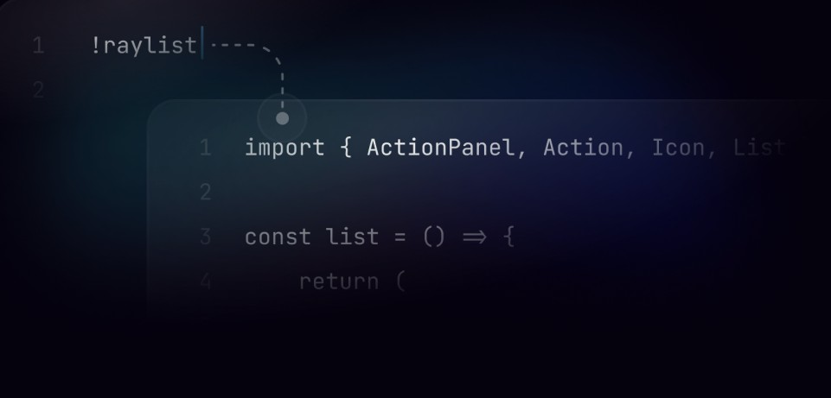


Watermarks
We're Locking Data
Embed immutable signatures in your data to assert your ownership. Deter unauthorized use, trace leaks,
and add guardrails to your data
Auto-Encryption
Automatically enforce data usage parameters in shared data environments. Ensure consistent adherence to policies and reduce the risk of data breaches

Slide 9



We’re Demystifying
Legal Terms
Scout Dashboard
ML NLP Contract Reader
Automatically extract key information from data usage agreements and insert into data instances
Integrations
Tag data-sets with usage rights in pre-existing data
management systems, catalyzing operation at scale & speed.
Know what your data means, and how you can use it
Trained on real contracts annotated by real lawyers
— with a real 98.9% Accuracy

Slide 10



We’re Creating New Data Revenue Streams
Composite Data
Automatically generate recommendations for new composite data assets that answer questions, unlock insight, and create new monetizable assets
Dashboard
Discover, track agreements and data usage rights all in one place — streamlining compliance and
enforcement

Slide 11








Meet the Team
Advisors
SVP @ John Wiley & Sons
Vikram Mahendru, Co-Founder & CEO
B.A. Economics, Empirical Modeling @ UChicago
Luc Scipio del Campo, Co-Founder & President of Operations
B.S. Computer Science, B.A. Business Economics @ UChicago
15+ Years in Ed-Tech
Fmr. SVP @ Walmart
Head of Data Governance & Monetization
Archie Graham, Co-Founder President of Strategy
B.S. Economics @ University College London
Alexander Baumgartner, Darren Peng — Developers
B.S. Computer Science @ UChicago
Exec Director @ Data Science Institute
Prev. @ Google, 10+ Years in Industry

Slide 12

Scout Revolutionizes the way Firms Protect & Monetize Data
Tech Partners & Integrations
Questions?
For the age of AI and the future of the data economy

Slide 13
APPENDIX
Market, Competive Analysis

Slide 14


Competitive Analysis
Cyber Security
ALTR: Data security platform designed to provide ultra- secure data access and storage. Limited to PII & PHI
Solidatus: Metadata management company. Helps companies understand how their data flows through their systems. No enforcement only observation
Immuta
Privacera
Scout
Immuta: Data security platform - helps to discover, secure and control sensitive data. Done Manually
Manual
BigID
Privacera: Data platform designed to combine data discovery and classification, centralized access management, and data de-identification. Only cost- center — rather than revenue generator
Automatic
Securiti
ALTR
Securiti: Privacy management software designed for data security, privacy, governance, and compliance in one place. Done manually
Solidatus
BigID: Data-driven protection and privacy compliance platform. Improves how enterprises protect and manage personal data privacy. Limited to PII & PHI
Data Insights
Our Competitors Use Manual, Limited Data Governance and Insight Tools - Our Algos to Serve Better Secure, and Empower Data

Slide 15





Consumer Data Market Sizing
Scout Consumer Analytics
Given just 10% of Consumer Analytics Market Size
$466
Mill
In 2024 - CA
SAM
ion
GR of 12.7%
US Consumer Analytics
Mordor Intelligence
$4.66 Billion
In 2024 - CAGR of 12.7%
Global Consumer Analytics
ReportLinker
$8.88 Billion
In 2022 - CAGR of 19.1%
TAM
Global Data Analytics
Precendence Research
$41.39 Billion
In 2022 - CAGR of 12.1%
Global Big Data
Harvard Business Review
$200.2 Billion
In 2023 - CAGR of 12.7%
Rapid growth in data verticals creates a market gap for Scout to step into through proprietary, integrated data governance & analysis algos

